Slide 1

The Art of Adaptation: matching cheese, port wine, and customer needs
By Jeff Heasman
linkedin.com/in/jeffheasman

Slide 2
Learning outcomes
By the end of this session, participants will be able to:
identify how evolving customer needs impact insurance product design and delivery.
understand the parallels between cheese and port wine pairings and strategic adaptation in business.
implement a strategy to tailor products, communications, and services to meet changing customer expectations.

Slide 3
The job to be done theory
Functional: What job is this pairing doing for your palate?
Emotional: How does this pairing make you feel?
Social: If you served this at a client event, what impression would it create?
If wine and cheese have functional, emotional and social jobs, why would we assume insurance products only have a functional job?

Slide 4
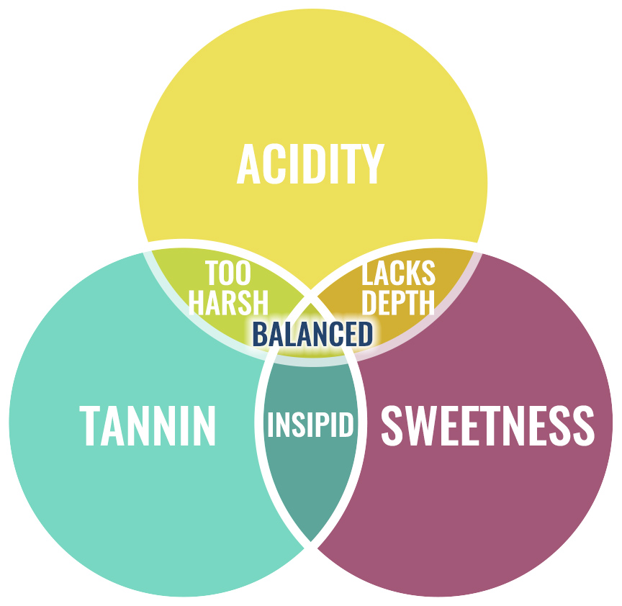

Slide 5
Wine: Langlois L'Extra Brut Crémant de Loire
Cheese: French Brie
Why the Pair: Crisp acidity and fine bubbles cut through the creamy texture of Brie. The palate is prepared.

Slide 6
Wine: Taylor's Fine White Port (2 to 3 years in oak vats)
Cheese: Soft goat’s cheese
Why the Pair: Citrus and floral notes complement the tangy freshness of goat's cheese.

Slide 7
Wine: Fonseca Bin 27 (Ruby) 4 years on oak vats
Cheese: Mature Cheddar
Why the Pair: Rich berry fruit balances the savoury intensity of mature cheddar.

Slide 8
Wine: Croft 2010 Colheita (Tawny – small oak casks for many years)
Cheese: Comte
Why the Pair: Nutty caramel flavours mirror the toasted notes in Comté, creating harmony.

Slide 9
Wine: Taylor's Late Bottled Vintage Port (4 – 6 years and one harvest)
Cheese: Stilton
Why the Pair: Sweet fruit balances the saltiness of Stilton to create one of the classic pairings.

Slide 10
Summary
Adapting to client needs is all about understanding the job to be done on the three levels:
  Functional
  Emotional
  Social

Slide 11
Restatement of learning outcomes
During this session, we have:
identified how evolving customer needs impact insurance product design and delivery.
understood the parallels between cheese and port wine pairings and strategic adaptation in business.
learnt how to implement a strategy to tailor products, communications, and services to meet changing customer expectations.

Slide 12



