Slide 1

To Pair or Not to Pair: what wine pairings can teach us about forming high quality connections.
By Jeff Heasman
linkedin.com/in/jeffheasman

Slide 2
Learning outcomes
By the end of this session, you will be able to:
identify the key cognitive functions that lead to stronger connections.
recognise the way in which we can harness emotional and cognitive functions for stronger connections.
implement a strategy to form high quality connections in our personal and professional lives.

Slide 3
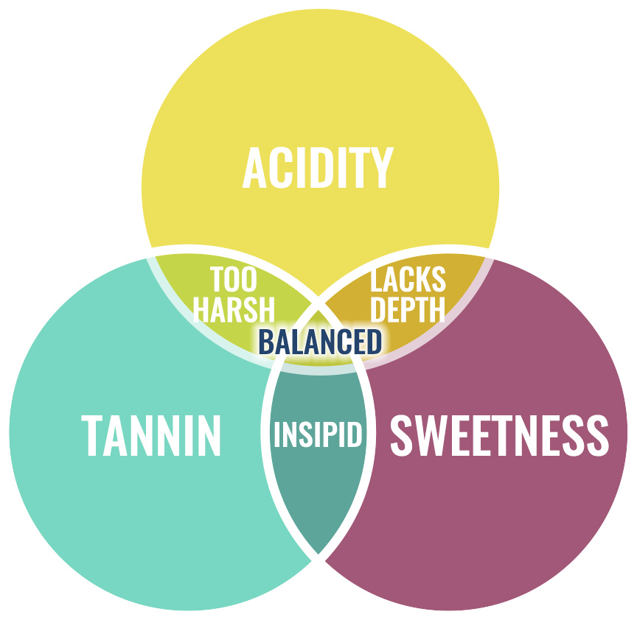

Slide 4
The Connections
As a rule of thumb, wine tasting is about seeking balance and relationships that complement. It is the same in our human relationships.
How not if – chocolate and wine. Sparkling wine paradox.
Balance – light food with light wine, heavier food with heavier wine. Opposites don´t attract.
Diversity – important in networks. Varietal wines produce easier pairings.
Not everything is better with age. Like some relationships, wines also fade.
Are you more like a convenor or a broker in your preferred networking style?

Slide 5
Relationships fade:
15% end because of a disagreement.
Between the age of 25 and 50, a man´s network shrinks by 35%, whereas a woman´s network shrinks by 20%.
Convenors = tannin, they help the wine age better. Convenors maintain relationships for longer but they are not diverse. The higher the tannin in the wine the less diversity in the pairing.
Brokers = have stronger relationships overall (easier to pair) but they don´t
have the long game of convenors (tannins).
Recommended book: Social Chemistry by Marissa King

Slide 6
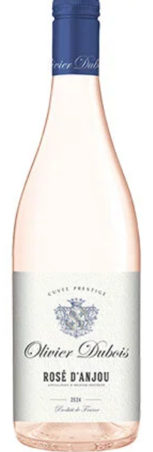
Olivier Dubois Rose d´Anjou 2024
90% Grolleau 10% Gamay
D.O. Loire
Notes: red berry and citrus
Pairing: ?

Slide 7
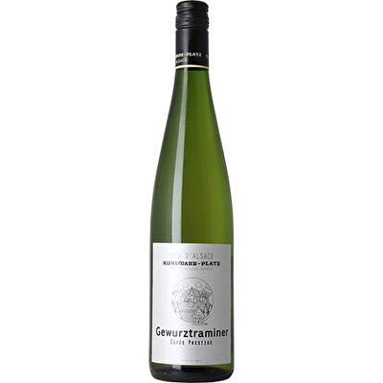
Hunawihr 2024
Gewurtztraminer
D.O. Alsace (Germany)
Notes: lychee, mango and white pepper
Pairing: ?

Slide 8
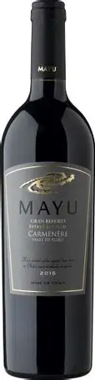
Mayu 2022 Gran Reserva
Pinot Noir
D.O. Elqui Valley
Notes: red fruits
Pairing: ?

Slide 9
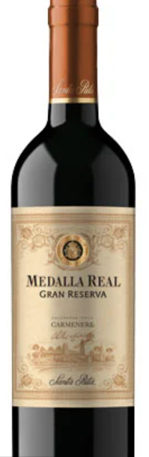
Santa Rita Medalla Real 2023 Gran Reserva
Carmenere
D.O. Colchagua
Notes: silky-smooth blueberry and plum
Pairing: ?

Slide 10

La Rame Gourmandise 2021
Semillon (Noble Rot)
D.O. Bordeaux
Notes: lemon, pineapple and mango
Pairing: ?

Slide 11
Restatement of learning outcomes
During this session, we have:
identified the key cognitive functions that lead to stronger connections.
recognised the way in which we can harness emotional and cognitive functions for stronger connections.
learnt how to implement a strategy to form high quality connections in our personal and professional lives.

Slide 12
