Slide 1
Marine Cargo Insurance – Part 3
Alan Hornby ACII
October 2024

Slide 2


Welcome
Notes:
This is one of three sessions on marine cargo insurance

Slide 3

Today’s objectives
List domestic and international legislation effecting marine cargo insurance
Explain what a Letter of Credit is and their importance in cargo insurance
Discuss the claims process and the documents needed

Slide 4
The claims process
The usual processes and procedures apply to marine cargo claims – at least for the policyholder ...

Slide 5

Notification
When reporting a claim, the insured will need to supply the following information:
Name and policy or certificate number and full contact details
The date of the incident giving rise to the claim
The details of the incident and the loss or damage that has occurred
Where the ship is currently located or moored – and whether she is moving or stopped
Where the ship is going and when she will reach that destination
Where any cargo is (and if it is still on the move, where it is heading)
Any other relevant information

Slide 6
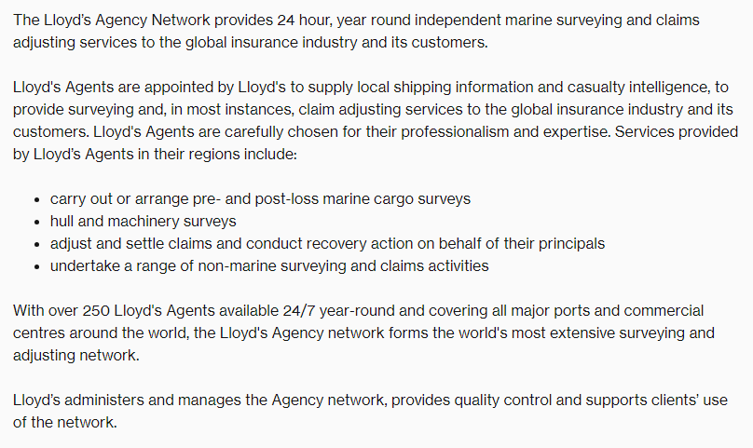

Slide 7

Documents required
Bill of Lading (both printed and electronic)
Waybills
Outturn report
Final delivery receipt

Slide 8

Proving Quantum
Sales invoice
An essential document this proves the sum paid by the buyer for the goods and shows the quantum for the claims.
Packing list
Provides information on the contents of each package or carton
Quantified statement of claim and/or repair invoice
This is the insured’s formal statement of the claim. If the cargo has been repaired the repair invoice shows where this is possible
Original certificate of insurance or policy document

Slide 9

Claim settled by marine cargo insurers – in full
Subrogation rights exercised
Liability - limited and defences available

Slide 10
Bill of Lading
A legal document issued by the carrier to a shipper

Slide 11

Shipper
The shipper is the party supplying the goods being transported
They are responsible for packing and preparing the shipment for transportation

Slide 12
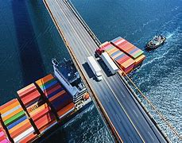
Carrier
The carrier is the party that moves the cargo
This could be the shipping line, haulage company or airline that carries the cargo

Slide 13

Consignee
The consignee is the party designated to receive the shipment

Slide 14
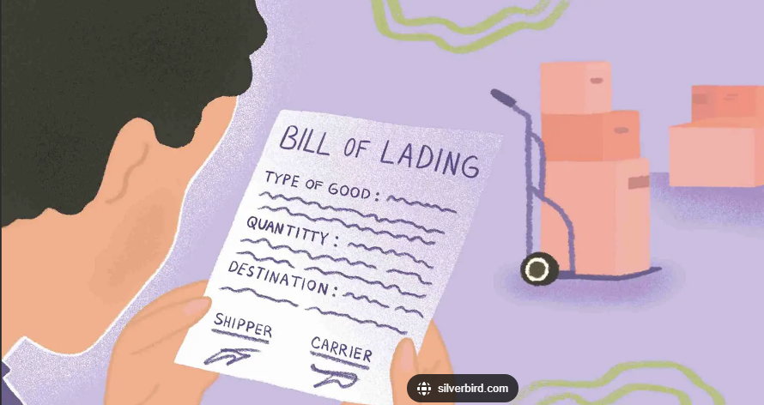
Bill of Lading
C
Contains details about which goods are being shipped, where the shipment is coming from and going to, as well as details of the shipper, carrier, and consignee.

Slide 15
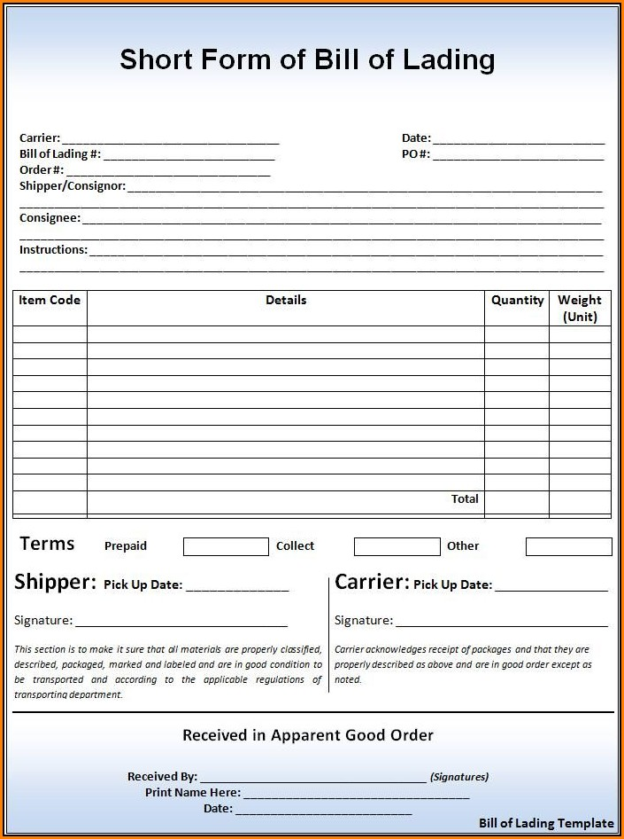
Bill of Lading – a legal document
The bill of lading has three main functions:
Evidence of a contract of carriage
Receipt of goods i.e. an acknowledgement that the carrier has received the freight
Document of legal title to goods

Slide 16
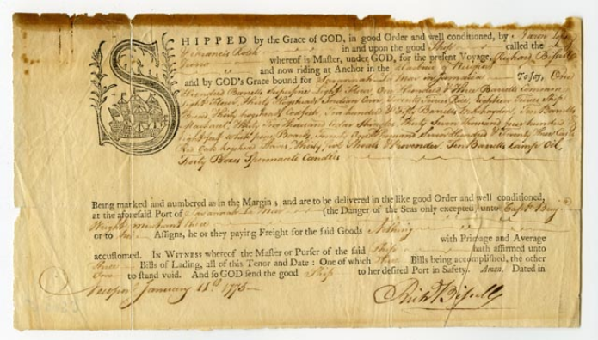
Bill – a statement of charges for either products or services that were rendered by the supplier or service provided to the buyer
Lading is the Old English word for ‘loading’ in the 16th century, which is when it was first issued

Slide 17
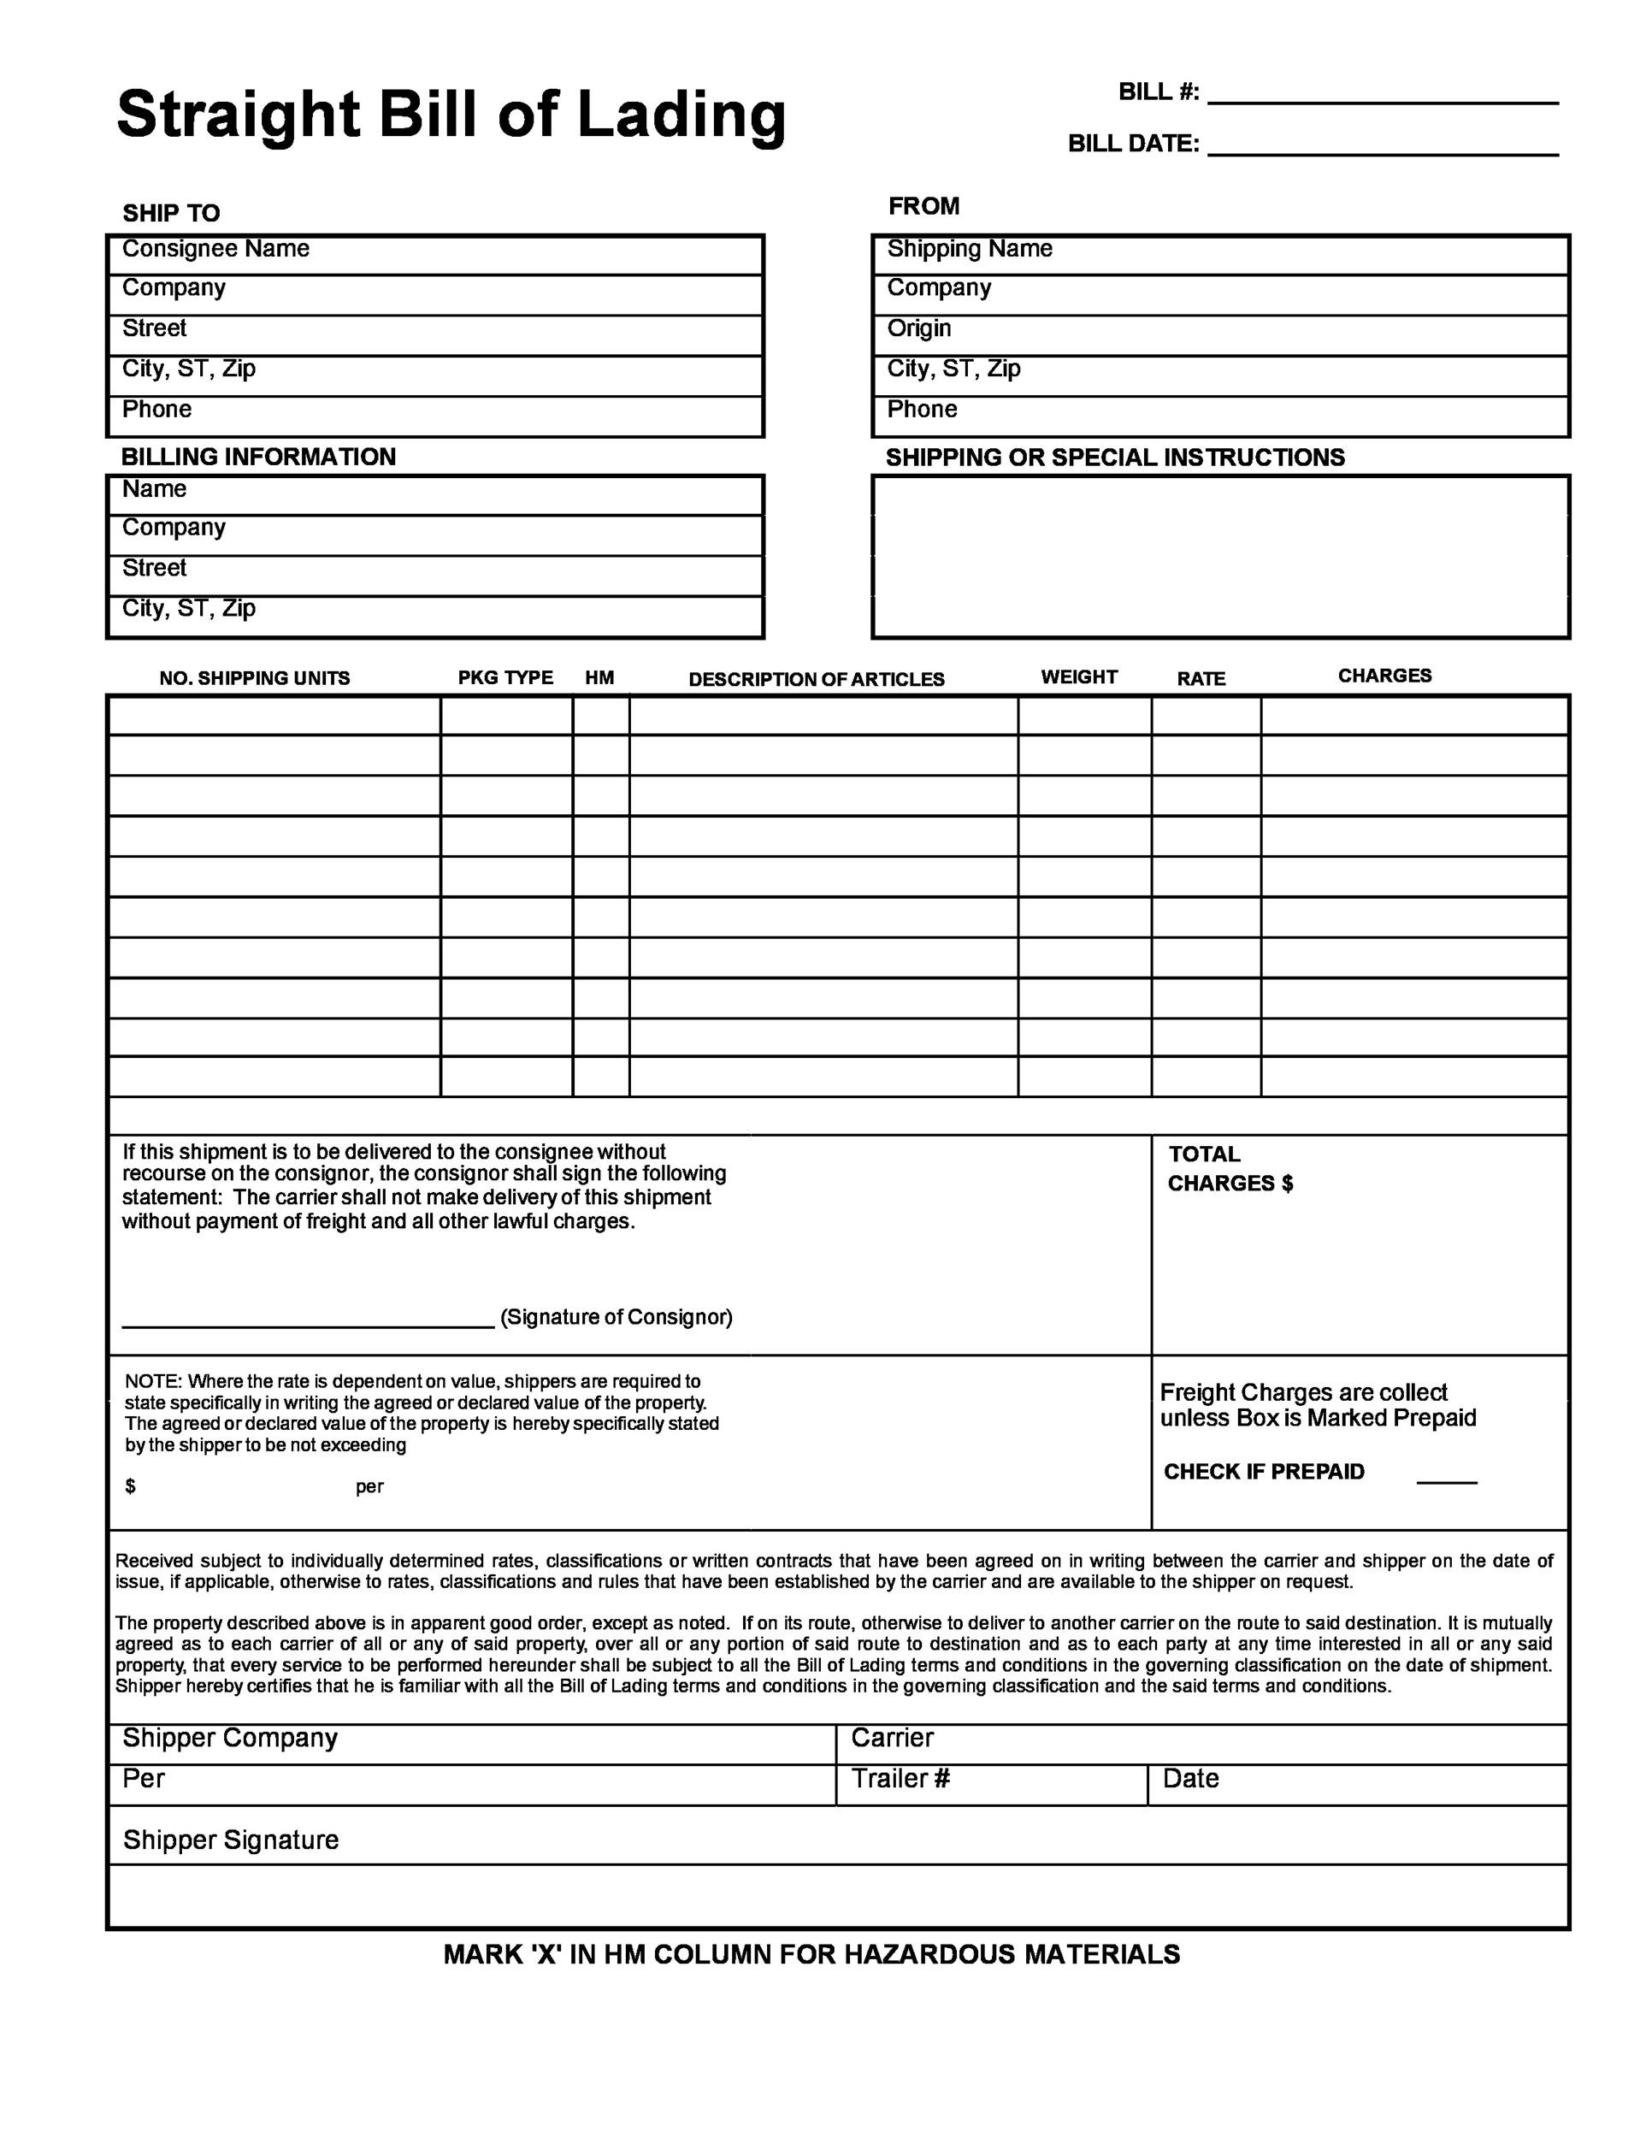
Information on a Bill of Lading
Name and address of the shipper
Name, address, and contact details of the receiver
Name, address, and contact details of the paying party
Date of Issue
Bill of Lading Number
Shipping Information
    Port of Loading
    Port of Discharge
    Vessel Name and Voyage Number
    Final Destination
Cargo Details
    Description of the cargo and the packaging used (ex: cartons, pallets, etc.)
    Gross Weight
    Total Volume
    Total Number of Cartons
    Container Number and container size
Special Notes or Instructions

Slide 18

Types of Bill of Lading
Ocean Bill of Lading – goods shipped over sea where shippers want to retain control over title of goods.
Sea Waybill – non-negotiable variant of the ocean bill of lading.
Master Air Waybill – freight shipments shipped by air.
Inland Bill of Lading – freight shipments shipped over land (rail or road).
Multimodal Bill of Lading – goods are shipped over more than one mode of transport. Sea + road, sea + rail etc.
House Bill of Lading – goods are shipped through a freight forwarder for Less than Container Load (LCL) or less than truckload (LTL) shipments.

Slide 19
Legislation

Slide 20
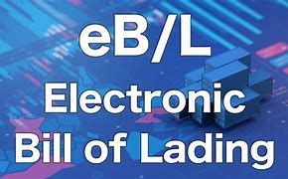
The Electronic Trade Documents Act 2023
Received royal assent on 20 July 2023
The Act permits electronic trade documents to be “possessed” in the same way as hardcopy documents, provided they are held on a “reliable system”
The ICC estimates that 80% of all bills of lading, as well as a majority of trade documents generally, operate under English law

Slide 21
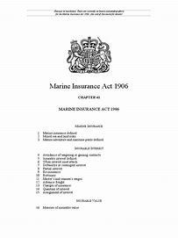
Marine Insuranc Act 1906
Duty of disclosure
  Amended by Insurance Act 2015
Uses the term peril to denote a hazard
Defines insurable interest
Seaworthiness warranty
Marine insurance policies should indemnify
Defines a marine adventure
States what can & cannot be insured

Slide 22
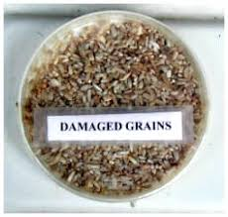
Notes:
You are a shipper – wanting to move goods
I am a ship owner
We agree a contract – I will carry a cargo of wheat from USA to France
My ship is registered in Panama
You are a British company – a subsidiary of a company whose Head Office in Rotterdam
On arrival in France, the cargo of wheat is found to be damaged – a mistake by the ship's crew who forgot to close the hatches properly
As the shipper who wants to sue, what do you do ?
Which court – USA, France, Panama, Britain, Netherlands ?
Did I promise to take care of your wheat ?
If I accept responsibility, I might not agree with the money you demand

Slide 23

International Conventions
Negotiating terms and conditions for each voyage is time consuming
Pre defined rules have been agreed and are in use in international shipping
1924 - Hague rules
International convention for the unification of certain rules and law relating to the bill of lading
These rules did have weaknesses and were amended – known as Hague Visby rules
I

Slide 24
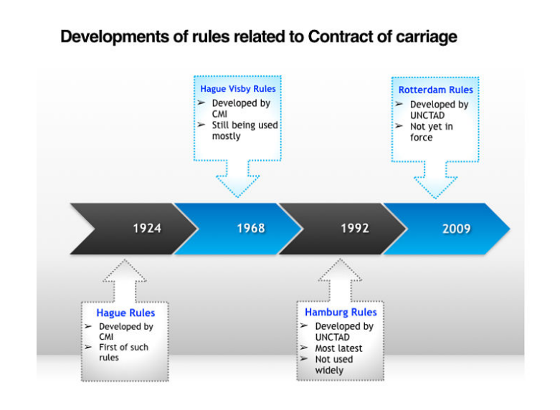

Slide 25
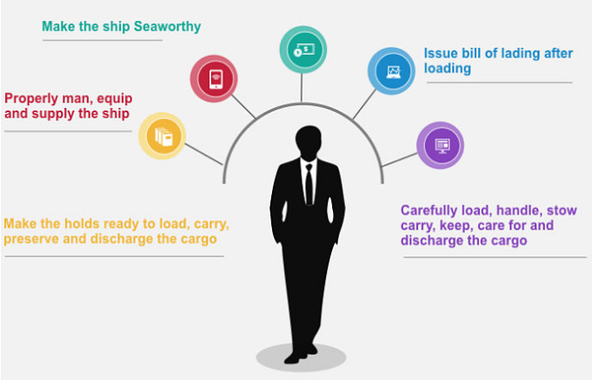
Carriers obligations

Slide 26
Carrier is not responsible for loss/damage
Acts, neglect, or default of the Master, mariner, pilot, or the servants of the carrier in the navigation or in the management of the ship
Fire, unless caused by the actual fault or privity of the carrier
Perils, dangers and accidents of the sea or other navigable waters;
Act of God
Act of war / Act of public enemies
Arrest or restraint or seizure under legal process
Quarantine restrictions
Strikes or lock outs or stoppage or restraint of labour
Riots and civil commotions
Saving or attempting to save life or property at sea#
Inherent defect,
Insufficiency of packing
Insufficiency or inadequacy of marks
Latent defects not discoverable by due diligence
Any other cause arising without the actual fault or privity of the carrier or without the fault or neglect of the agents or servants of the carrier

Slide 27
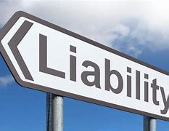
Liability for loss or damage
Unless the nature and value of such goods have been declared by the shipper before shipment and inserted in the bill of lading, neither the carrier nor the ship shall in any event be or become liable for any loss or damage to or in connection with the goods in an amount exceeding 666.67 units of account per package or unit or 2 units of account per kilogramme of gross weight of the goods lost or damaged, whichever is the higher
Unit = SDR = £1.01 as at 30.9.24

Slide 28
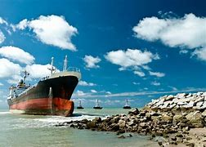
York Antwerp Rules
The York Antwerp Rules are a set of maritime regulations surrounding jettisoned cargo
Date back to 1890
The rules are a codification of the law of general average

Slide 29
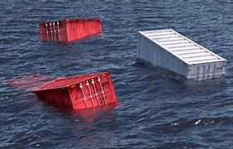
The danger to the ship must be imminent
There must be a voluntary jettison of a portion of the ships cargo in order to save the whole
The attempt to avoid the danger must be successful
If a situation meets all these stipulations, all parties involved in the maritime adventure must share proportionately in the financial burden of the losses incurred to the owner or owners of any of the cargo that was jettisoned in order to save the vessel

Slide 30
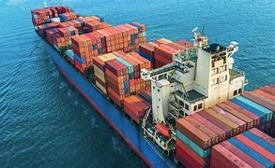
Carriage of Goods by Sea Act 1992
Incorporated Hague-Visby rules into English Law
Rules apply
  The bill of lading is issued in a contracting State, or
  The carriage is from a port in a contracting State, or
  The contract of carriage provides that the Rules are to govern the contract
Bill of lading to be conclusive evidence of receipt for shipment

Slide 31
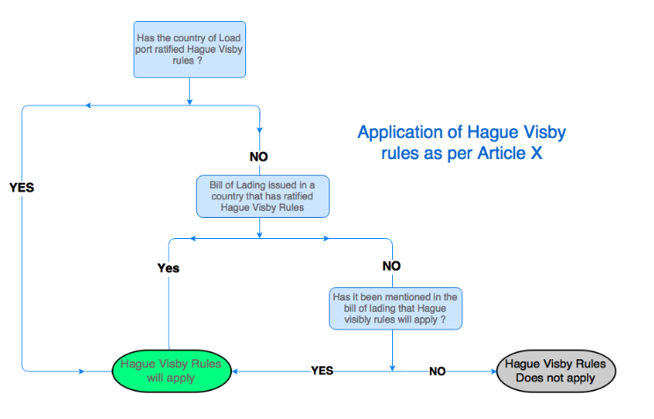

Slide 32

Road Transits
Hauliers will limit their liability for loss of or damage to goods
Customer responsible for loading/unloading
Force Majeure defence applies

Slide 33
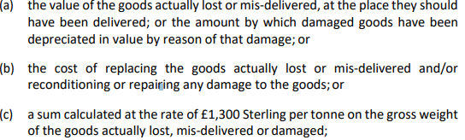
RHA – Limitaion of Liability

Slide 34
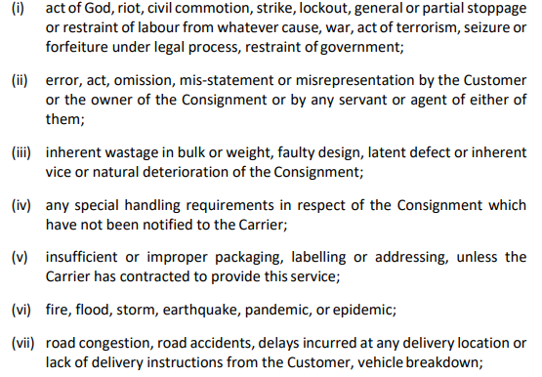
RHA – Force majeure

Slide 35
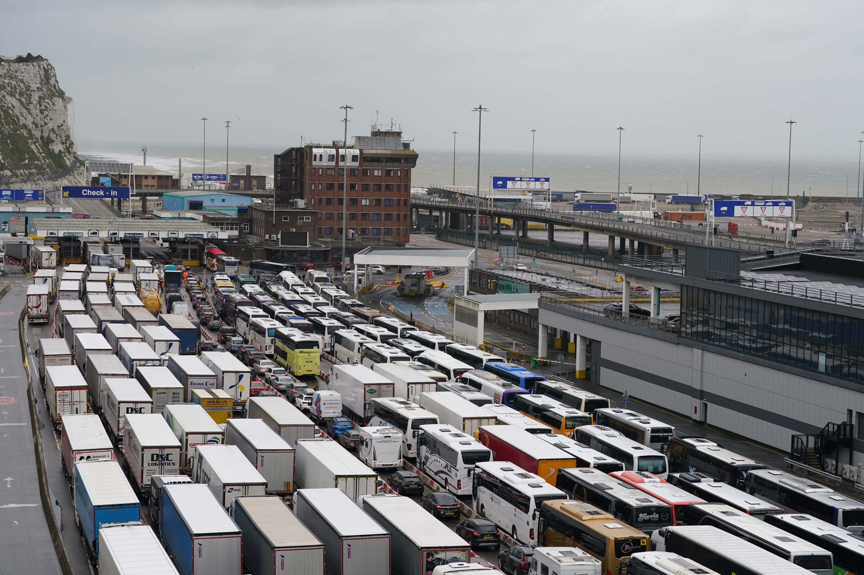
CMR
Statutory rules applying to movement of goods internationally
Convention relative au contrat de transport international de merchandises par route
Incorporated into UK law - Carriage of Goods by Road Act 1965
Cannot opt out of a CMR movement

Slide 36
CMR
Statutory rules applying to movement of goods internationally
Convention relative au contrat de transport international de merchandises par route
Incorporated into UK law - Carriage of Goods by Road Act 1965
Cannot opt out of a CMR movement

Slide 37

CMR Liability
Carrier's liability is limited to 8.33 SDR per kilogram for total or partial loss of the goods
Approx £8,400 per tonne
In case of delay, the damages are limited to the amount of the charges for carriage

Slide 38

CMR Defences
The claimant's wrongful act or neglect
The claimant's instructions, unless they were the result of the carrier's own wrongful act or neglect
The inherent vice of the goods
Circumstances that the carrier could not avoid and the consequences of which they could not prevent

Slide 39
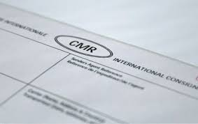
The CMR note: the key road transport document
The CMR note confirms that the carrier - the road haulage company- has received the goods and that a contract of carriage exists between the trader and the carrier
Unlike a bill of lading, a CMR note is not a document of title nor a declaration, although some states regard it as such

Slide 40

Details on a CMR note
Date and place at which the CMR note has been completed
Name and address of sender, carrier(s) and consignee (the person to whom the goods are going)
Description of the goods and their method of packing
The weight of the goods
Any charges related to the goods, such as customs duties or carriage charges
Instructions for customs and any other formalities such as dangerous goods information

Slide 41

Distribution chain

Slide 42
Letter of Credit

Slide 43

A common situation in trade ...
Buyer
Won't make payment until goods are received in good order
Seller
Won't send goods until paid for

Slide 44

We shall overcome … !
A Letter of Credit is a contractual commitment by the foreign buyer’s bank to pay once the exporter ships the goods and presents the required documentation to the exporter’s bank as proof.
As a trade finance tool, Letters of Credit are designed to protect both exporters and importers

Slide 45
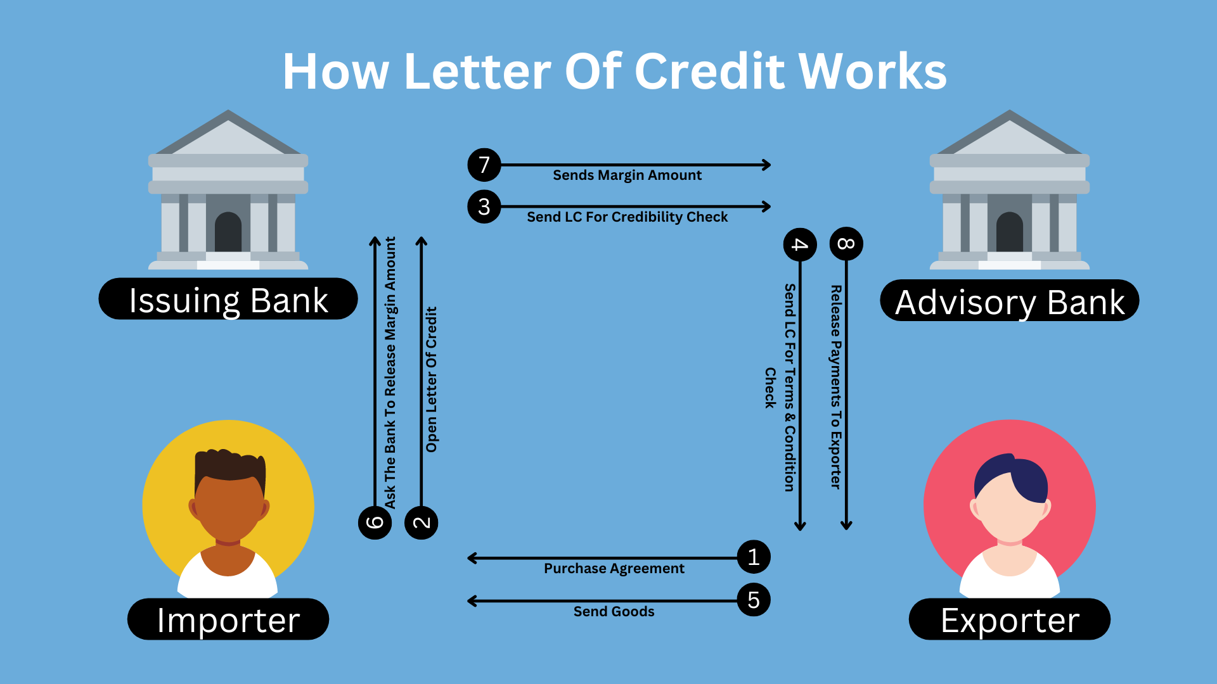

Slide 46
Letter of Credit
Advantages
Disadvantages
Can create security and build mutual trust for buyers and sellers in trade transactions.
Makes it easier to define the specifics of when and how transactions are to be completed between involved parties.
Letters of credit can be personalized with terms that are tailored to the circumstances of each transaction.
Can make the transfer of funds more efficient and streamlined.
Buyers typically bear the costs of obtaining a letter of credit.
Letters of credit may not cover every detail of the transaction, potentially leaving room for error.
Establishing a letter of credit may be tedious or time-consuming for all parties involved.
The terms of a letter of credit may not account for unexpected changes in the political or economic landscape.

Slide 47

Letters of credit & Marine Insurance certificates

Slide 48

List domestic and international legislation effecting marine cargo insurance
Explain what a Letter of Credit is and their importance in cargo insurance
Discuss the claims process and the documents needed

