Slide 1


A Masterclass in Stress Management
Presented by: Steve Heath, Mental Health in Business

Slide 2
A Masterclass in Stress Management
Presented by: Claire Russell, & Steve Heath, Mental Health in Business

Slide 3


Steve Heath
Co-founder and Director,
Mental Health in Business
Website: http://www.mhib.co.uk/
Email: steve@mhib.co.uk
Mobile: 0781 403 1793

Slide 4

Claire Russell
Founder and CEO
Mental Health in Business
Website: http://www.mhib.co.uk
Email: claire@mhib.co.uk
Mobile: 07970961454

Slide 5
Session Objectives
By attending this presentation delegates should be able to:
Summarise the negative effects of stress.
Identify possible stressors with clarity.
Describe thoughts, habits, attitudes, and behaviours which may be contributing to feelings of stress.
Explain the four pillars of stress management.
Develop some positive, healthy ways of managing stress.

Slide 6
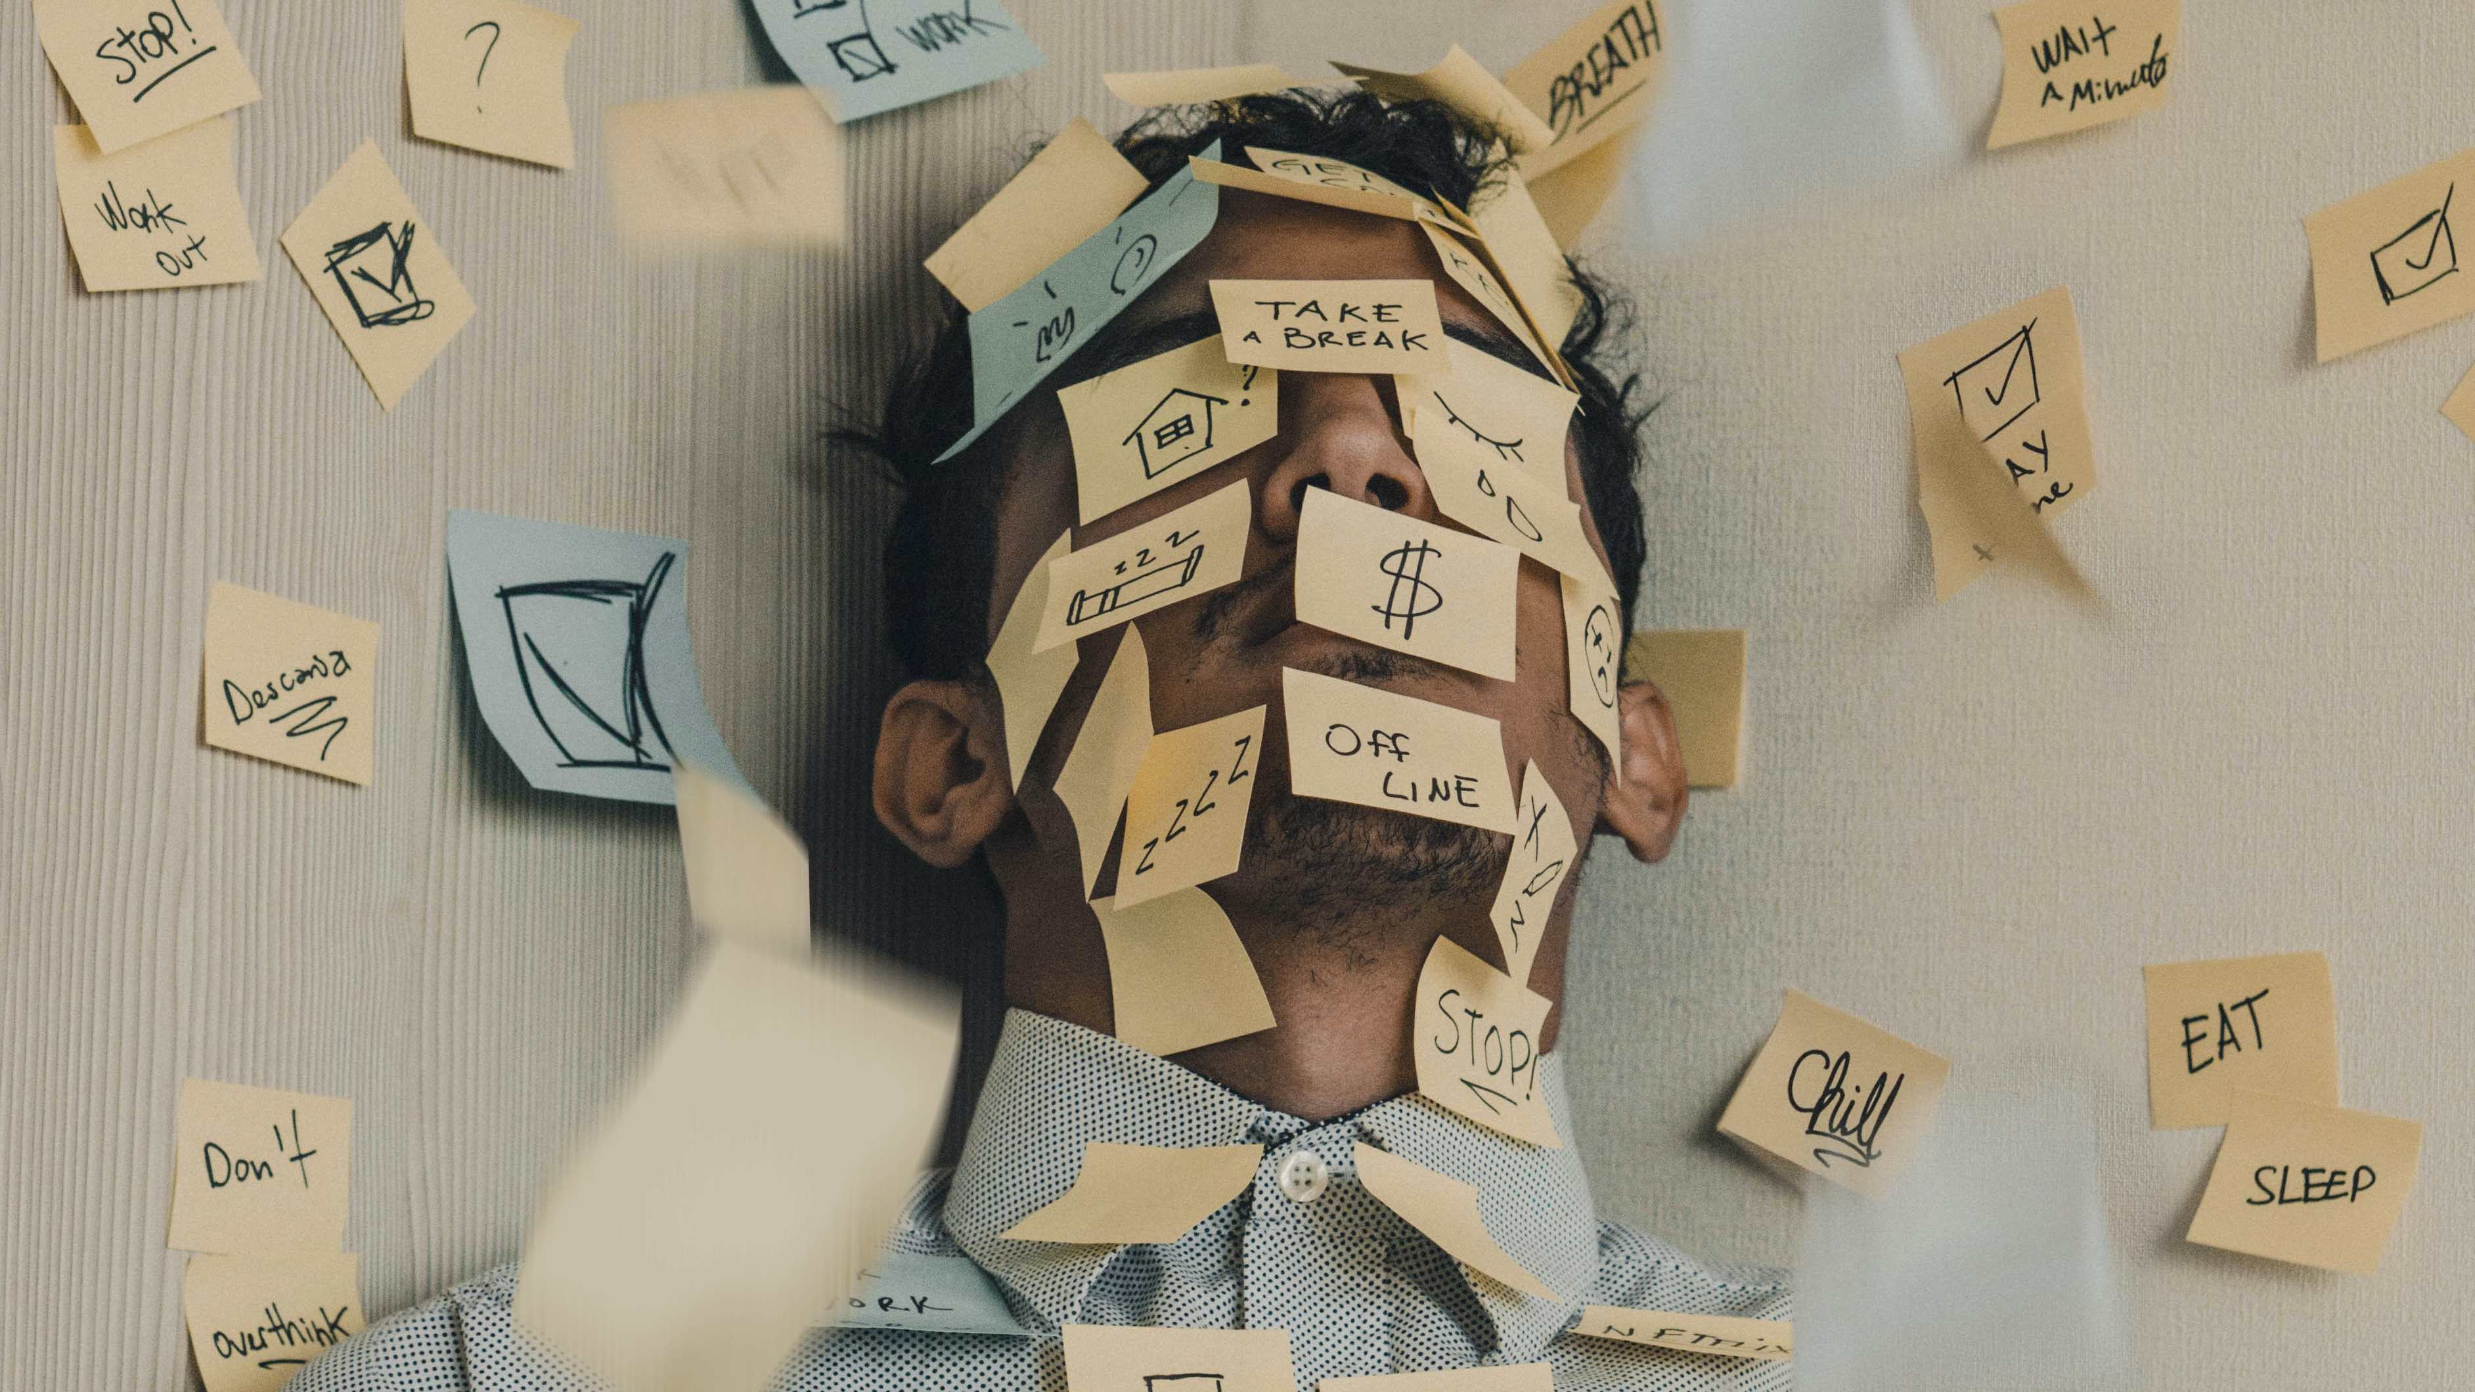

Slide 7

What are some thoughts, attitudes or behaviours that might contribute to stress?

Slide 8
Habits, attitudes & behaviours that contribute to stress
Habit / attitude / behavior | Example
Rationalising away stress as temporary | “I just have so much work to do right now.”
Describing stress as an integral part of your home or work life | “Things at work are always hectic.”
Using stress to define your personality | “I have nervous energy. I am wired like that”
Blaming stress on circumstances or other people | “My boss is overworking me.”
Viewing stress as a normal | “It’s nothing new -- working here is quite demanding, but I am used to it.”

Slide 9
AVOID
ALTER
ADAPT
ACCEPT
Learn to say NO.
Avoid people who induce stress in your life.
Take more control of your environment.
Go through your to-do list and reduce your workload.
Communicate your feelings rather than bottle them up.
Respectfully ask others to change their behavior.
Compromise.
Change how you view problems.
Put it in perspective.
Change your standards.
Stop negative thoughts as they occur.
Be grateful.
Don't try and control everything.
Talk to someone.
Learn to forgive yourself and others.
Learn from your mistakes.
Look on the bright side.
1
2
3
4

Slide 10
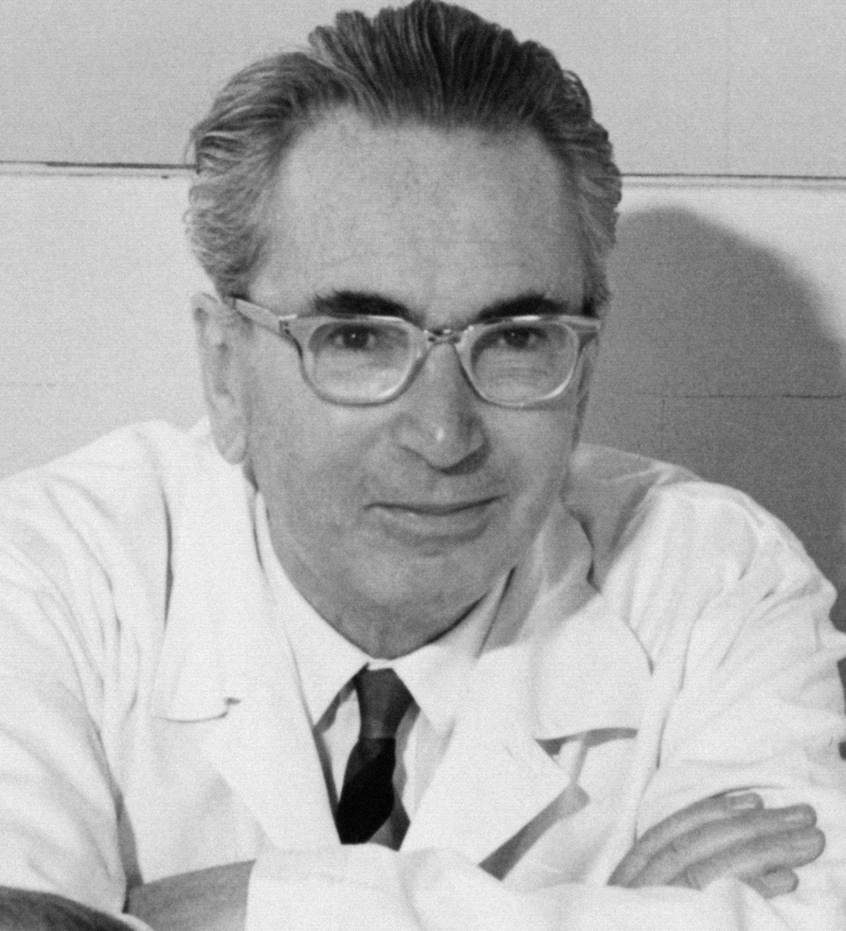
“There is a space between stimulus and response. That space contains our power to choose how we respond and our growth and freedom lies in our response.”
Viktor E Frankl, Psychologist, Holocaust Survivor and Author of ‘A Mans Search for Meaning’.

Slide 11
Before starting a mindfulness practice…
There are some things you should keep in mind before starting your mindfulness practice:
When you begin, you will find that it is different than what you were expecting.
Mindfulness is not about fixing you.
It is also not about stopping your thoughts.
Some people are wary of trying mindfulness.
It is not a way to escape your reality.
It does more than just reduce your stress.
Mindfulness can also boost your neural connections.

Slide 12




Body scan Meditation
Walking Meditation
Breathing Exercises
Object Meditation

Slide 13


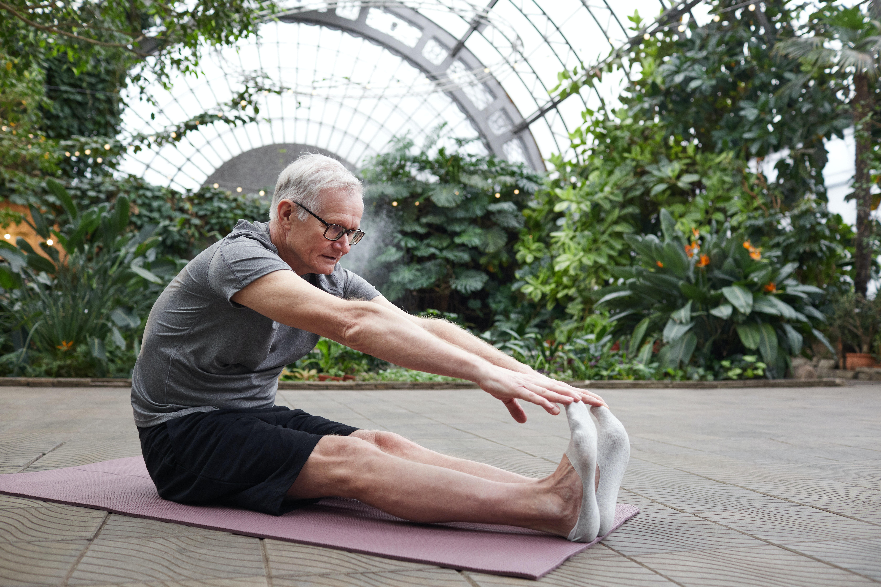
Loving Kindness Meditation
Mindful Eating
Stretching Mindfully

Slide 14
Session Objectives
By attending this presentation delegates should be able to:
Summarise the negative effects of stress.
Identify possible stressors with clarity.
Describe thoughts, habits, attitudes, and behaviours which may be contributing to feelings of stress.
Explain the four pillars of stress management.
Develop some positive, healthy ways of managing stress.

Slide 15
Steve Heath
Co-founder and Director,
Mental Health in Business
Website: http://www.mhib.co.uk/
Email: steve@mhib.co.uk
Mobile: 0781 403 1793

Slide 16
Claire Russell
Founder and CEO
Mental Health in Business
Website: http://www.mhib.co.uk
Email: claire@mhib.co.uk
Mobile: 07970961454

