Slide 1




The Consumer Duty Skills Toolkit – Part 1
by
Jeff Heasman MABP, PGCert CELTA, LL.B (Hons), LL.M
Certified Practitioner Member of the Academy of Modern Applied Psychology
Member of the Association for Business Psychology
linkedin.com/in/jeffheasman

Slide 2

Learning objectives
By the end of the session, participants will be able to:
identify the key requirements relating to consumer understanding and consumer support under the Consumer Duty.
understand the key elements of outcomes-based regulation and skills necessary to evidence outcomes.
implement a strategy to utilise the skills taught to remain on the right side of the new Consumer Duty

Slide 3
The skills toolkit
Part 1
Communicating in a way that aids accessibility and understanding.
Checking understanding to facilitate informed decision-making.
Part 2
Recognising and dealing with vulnerable customers.
Recognising and handling behavioural biases throughout the customer journey.
Note: throughout the Consumer Duty the FCA make a very strong link between behavioural biases and vulnerable customers.

Slide 4
Working in the real world
Principle 12
“… focus on the outcomes customers get, and act in a way that reflects how consumers actually behave and transact in the real world, better enabling them to access and assess relevant information, and to act to pursue their financial objectives.”

Slide 5
Customer understanding
Builds on Principle 7 (TCF):
Communications must:
meet the information needs
be likely to be understood by customers intended to receive the communication
facilitate informed decisions
taking into account the characteristics of the customers intended to receive the communication

Slide 6
You must:
ask them if they understand the information and have any further questions
test, monitor and adapt communications to support understanding and good outcomes for customers

Slide 7
Communication channels
It is important to respect the customer´s preferred communication channel but also note Paragraph 8.28:
“A firm might also consider requiring customers to interact with the firm via another channel before making a decision such as buying a product or service, where the other channel is likely to facilitate a fuller consideration of important information.”

Slide 8
Tailoring communication
Paragraph 8.31 requires firms to
“… take into account what they know, or could reasonably be expected to know, about the sophistication, financial capabilities and vulnerability of the intended recipients of the communications and tailor them to meet their information needs as appropriate.”

Slide 9
Remember the real world?
Paragraph 8.39:
“Firms may consider their communications to be understandable, but that may only reflect the views of those involved in the design and sign-off of their communications – often legal, compliance and other financial services professionals.”

Slide 10
Testing understanding
Readability testing for standard communications.
Paragraph 8.73:
“adopt a ‘test and learn approach’, adapting communications where appropriate with the aim of improving customer understanding to support good outcomes.”

Slide 11
Customer support
At the heart of this pillar is providing support that meets the needs of the customer.
Paragraph 9.4:
“Under the consumer understanding outcome firms should communicate with customers in a way that equips them to make effective, timely and properly informed decisions.
Under the consumer support outcome firms should enable customers to act on these decisions without facing unreasonable barriers.”
Particular focus on vulnerable customers. Paragraph 9.37 deals with representatives of vulnerable customers.

Slide 12
How does outcomes-based regulation work?
Inputs Outputs Outcomes
The skills / The activities What is to be resources needed to achieve the achieved / what the to achieve the outcomes. client vales.
outcomes.
The regulator sets the outcomes to be achieved.
The firm has freedom in terms of the inputs and outputs to achieve the outcomes.

Slide 13



Slide 14
Communicating in a way that aids accessibility and understanding

Slide 15
Plain language is the key
Plain language = Simplicity
Simplicity = Understanding
Understanding = Transparency
Transparency = Honesty
Honesty = Trust
Trust = Customers
www.comprehensible.co.uk

Slide 16
Step 1
Read & Understand It Yourself

Slide 17
How many people can honestly admit to having read and understood the entire policy/product documents?
The duties of the broker/advisor/intermediary go beyond those of being a post box.
Inconsistencies or ambiguities will be construed against the drafter.

Slide 18
Step 2
Don´t Wear Legalese Goggles

Slide 19
Each policy will have definitions but …
“If interpretation is the quest to discover what a reasonable man would have understood specific parties to have meant by the use of specific language in a specific situation at a specific time and place, how can that be affected by authority?”
Lord Hoffmann in Bank of Credit and Commerce International SA v Ali [2001] UKHL 8

Slide 20
Step 3
Remove the Junk & the Clunk

Slide 21
The due observance and fulfilment of the terms so far as they relate to anything to be done or complied with by the Insured and the truth of the statements and answers in the Proposal shall be conditions precedent to any liability of the Company to make any payment under this policy.
Taken from ‘Language on Trial’ by the Plain English Campaign

Slide 22
How do we remove the junk and clunk?
Keep sentences short and avoid surplus words (in the event that).
Avoid archaic words (herewith), couplets (unless and until) and jargon (condition precedent).
Avoid ambiguity (shall).
Avoid nominalisations (We shall only make a payment under this policy if … / We will only pay under this policy if … ).

Slide 23
Compound phrases
as prescribed by under
in accordance with by, under
in the course of in, while, during
in the event that if
on behalf of for
provided that if
until such time as until

Slide 24
Archaic language - couplets
alter or change
cease and desist
do and perform
for and during the period of
full and complete
made and entered into
order and direct
save and except

Slide 25
Step 4
Lift the Fog

Slide 26
Think about accessibility as well as readability.
Use lists where appropriate and limit cross-references (accessibility).
Think about the hierarchy of information.

Slide 27
The due observance and fulfilment of the terms so far as they relate to anything to be done or complied with by the Insured and the truth of the statements and answers in the Proposal shall be conditions precedent to any liability of the Company to make any payment under this policy.
Taken from ‘Language on Trial’ by the Plain English Campaign

Slide 28
We will only pay under this Policy if:
you have kept to the terms of the Policy; and
the statements and answers in your Proposal are true.
Taken from ‘Language on Trial’ by the Plain English Campaign

Slide 29
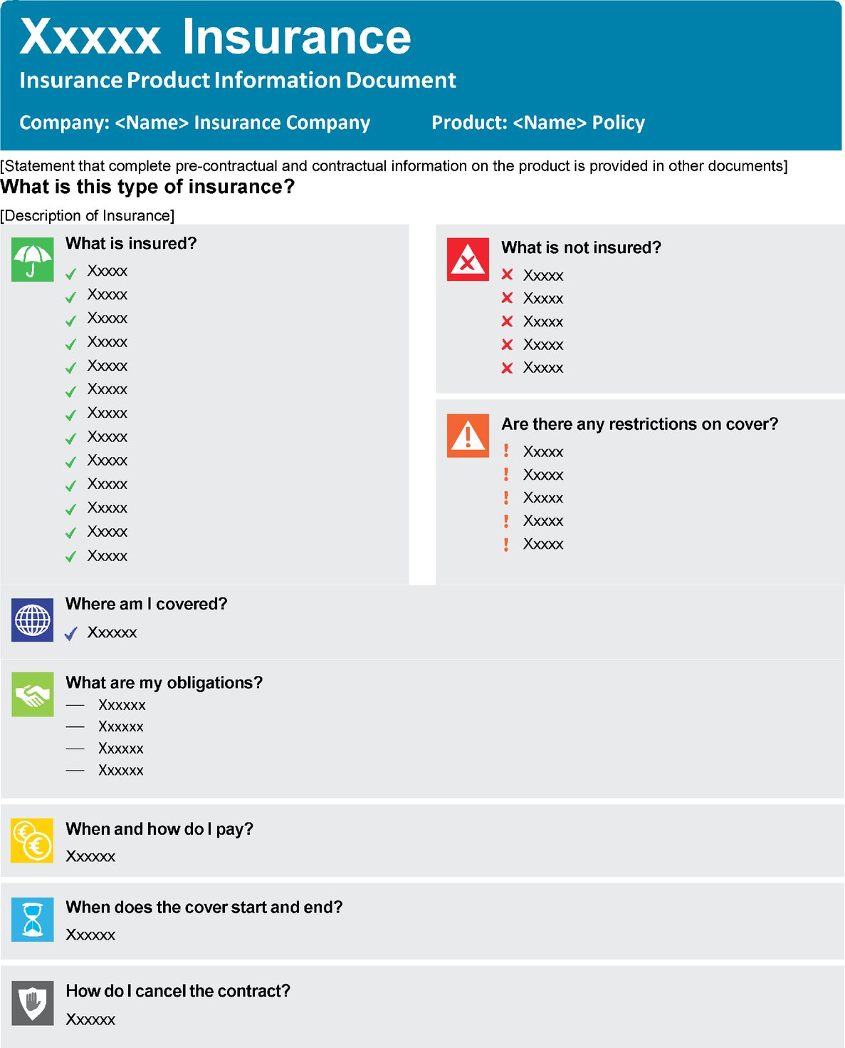

Slide 30
Step 5
Enlighten

Slide 31
In other words …
You will truly enlighten the customer when you are able to do the following:
read and understand the text.
take notes of the main points.
cover the original.
remove the junk and the clunk
think about how to restructure.
check against the original.

Slide 32
The 5 steps
Read and understand the policy yourself.
Don´t wear the legalese goggles.
Remove the junk and the clunk.
Lift the fog.
Enlighten.

Slide 34
Checking understanding to facilitate informed decision-making

Slide 35
Concept checking
A skill taught to teachers during training, especially language teachers.
An unobtrusive way of testing if someone has truly listened to, and understood, your advice.
It is important to avoid questions such as:
Do you have any questions for me? (and relying on no)
Is that clear? Do you understand? (and relying on yes)
Is there anything you didn´t understand? (and relying on no)
Think back to how you would typically respond to such questions at school.

Slide 36
Why is this important?
Our legal and regulatory duties require us to ensure we have explained and the client has understood.
The Consumer Duty: outcome based regulation.
Regardless of the duties placed upon us, it is just good practice.
It reduces the risk of any loss of trust or loyalty in the future.
It reduces the risk of reputational damage.

Slide 37
Vulnerable customers
October 2020: 53% of UK adults classified as being vulnerable.
Vulnerability includes capability: low knowledge of financial matters and low literacy skills.
Remember that the 2012 Act requires you to take into account the specific characteristics of the actual consumer.

Slide 38
The illusion of communication
You must paraphrase complicated information and apply it to the customer´s specific circumstances.
In other words, what this means is …
The way this applies to your situation is …
Concept check to ensure understanding.

Slide 39
The 4 levels of communication
What I intended to say.
What I actually said.
What I think the other person understood.
What they actually understood.

Slide 40
Introducing SURE
Summarise
Understanding check
Repeat (client´s answer or
repeat advice)
Embed

Slide 41
Summarise
The summary should have two parts:
1) A summary of the key points of the advice, in plain language.
2) An explanation of how it applies to the client´s specific circumstances.

Slide 42
Understanding check
It is at this point that the concept question is asked.
You cannot “test” all of your advice but rather you need to “test” a cross-section.
The following is important:
Plan the questions ahead of the discussion.
Don´t use jargon/unfamiliar language.
Ask one question at a time.
Use a mix of closed questions and open/probing questions.
A danger with closed questions is that they have a 50% chance of getting the answer right. Never use leading questions.

Slide 43
Repeat
If the client answers correctly, acknowledge and repeat the advice.
If the client doesn´t answer correctly, repeat the advice and repeat the same concept checking question.

Slide 44
Embed
This will occur naturally through the repetition and questioning.
If you follow the S, U & R of SURE, you can be confident that the knowledge has been embedded in the client´s mind and it has been understood.

Slide 45
A practical example
The due observance and fulfilment of the terms so far as they relate to anything to be done or complied with by the Insured and the truth of the statements and answers in the Proposal shall be conditions precedent to any liability of the Company to make any payment under this policy.
Taken from ‘Language on Trial’ by the Plain English Campaign

Slide 46
Summarise
The insurer will only pay if you keep to the terms of the policy and the statements and answers in your proposal are true.
Understanding check
Can the insurer refuse to pay if you don´t keep to the terms of the policy? (closed)
What will happen if the statements and answers in your proposal aren´t true? (open)
Repeat
That´s right, if the statements and answers in your proposal aren´t true, the insurer may refuse to pay.
or
Unfortunately, that isn´t correct. Together, let´s look again at the term … (use inclusive language and ask the question again).
Embed
Hey presto!

Slide 47
Summarise
Some of the advantages of moving cash into bonds are x, y and z.
Understanding check
Is y one of the advantages of moving cash into bonds? (closed)
Can you remind me of one of the advantages of moving cash into bonds? (open)
Repeat
That´s right, one of the advantages of moving cash into bonds is y.
or
Unfortunately, that isn´t correct. Together, let´s look again at the advantages of moving cash into bonds … (use inclusive language and ask the question again).
Embed
Hey presto!

Slide 48
Summary
Without some form of unobtrusive testing we cannot be confident that the client has listened to, and understood, our advice.
We need to prepare the questions we ask.
The SURE technique will improve relationships and increase trust and loyalty.

Slide 50
Restatement of learning objectives
During this session, we have:
identified the key requirements relating to consumer understanding and consumer support under the Consumer Duty.
understood the key elements of outcomes-based regulation and skills necessary to evidence outcomes.
learnt how to implement a strategy to utilise the skills taught to remain on the right side of the new Consumer Duty

Slide 51
The Consumer Duty Skills Toolkit – Part 2
by
Jeff Heasman MABP, PGCert CELTA, LL.B (Hons), LL.M
Certified Practitioner Member of the Academy of Modern Applied Psychology
Member of the Association for Business Psychology
linkedin.com/in/jeffheasman

Slide 52
Learning objectives
By the end of the session, participants will be able to:
identify the key requirements relating to consumer understanding and consumer support under the Consumer Duty.
understand the key elements of outcomes-based regulation and skills necessary to evidence outcomes.
implement a strategy to utilise the skills taught to remain on the right side of the new Consumer Duty

Slide 53
The skills toolkit
Part 1
Communicating in a way that aids accessibility and understanding.
Checking understanding to facilitate informed decision-making.
Part 2
Recognising and dealing with vulnerable customers.
Recognising and handling behavioural biases throughout the customer journey.
Note: throughout the Consumer Duty the FCA make a very strong link between behavioural biases and vulnerable customers.

Slide 54
Recognising and dealing with
vulnerable customers

Slide 55
Preface
“A vulnerable customer is someone who, due to their personal circumstances, is especially susceptible to harm, particularly when a firm is not acting with appropriate levels of care.”
FG 21/1
Guidance for firms on the fair treatment of vulnerable customers
February 2021
The guidance “does not provide a checklist of required actions…Firms will need to use their judgement to decide precisely what the Guidance means for them.” (size, market, products, characteristics of its target market)
Applies to retail customers (natural persons) but firms may want to take the Guidance into consideration when dealing with a representative of an incorporated business.

Slide 56
Health: health conditions or ability to carry out day-to-day tasks.
Life events: such as bereavement, job loss or relationship breakdown.
Resilience: low ability to withstand financial or emotional shocks.
Capability: low knowledge of financial matters or low confidence in managing money. Also includes literacy and digital skills.
See paragraph 2.9 in the Guidance for a list of examples.

Slide 57
February 2020: 46% of UK adults (24.1 million people) had characteristics of vulnerability.
October 2020: this had risen to 53%.
Has another lockdown and the cost of living crisis increased this even further?
A majority of UK adults now fall within the category of “vulnerable”.
Firms need to overhaul their communication strategies.

Slide 58
Paragraph 4.67:
“If needs cannot be accommodated within standard communications, firms should provide different formats where it is proportionate to do so, particularly for key documents.”
Communication channels should include:
Telephone
Email
Branch
Text
Written
Web-chat
Video calls

Slide 59
Not every customer is “reasonable”
The Consumer Insurance (Disclosure and Representations) Act 2012 (section 3 – reasonable care)
Misrepresentations. How clear and specific were the questions that were asked of the consumer? How complex are the questions?
The duty is that of the “reasonable” consumer but “particular characteristics” or “circumstances” of the “actual consumer” will be taken into account.
FCA: “We expect firms to provide their customers with a level of care that is appropriate given the characteristics of the customers themselves.” para 1.6
“… we have regard to the general principle that consumers should take responsibility for their choices and decisions.” para 1.4

Slide 60
Key areas of focus
Frontline staff.
Product development.
Culture from senior leaders.
Policies and processes must embed the fair treatment of vulnerable customers.
The key is to apply some general principles around communication and ensure these are being utilised (and evidenced) but also ensure there is flexible service provision and communications (e.g. channels).

Slide 61
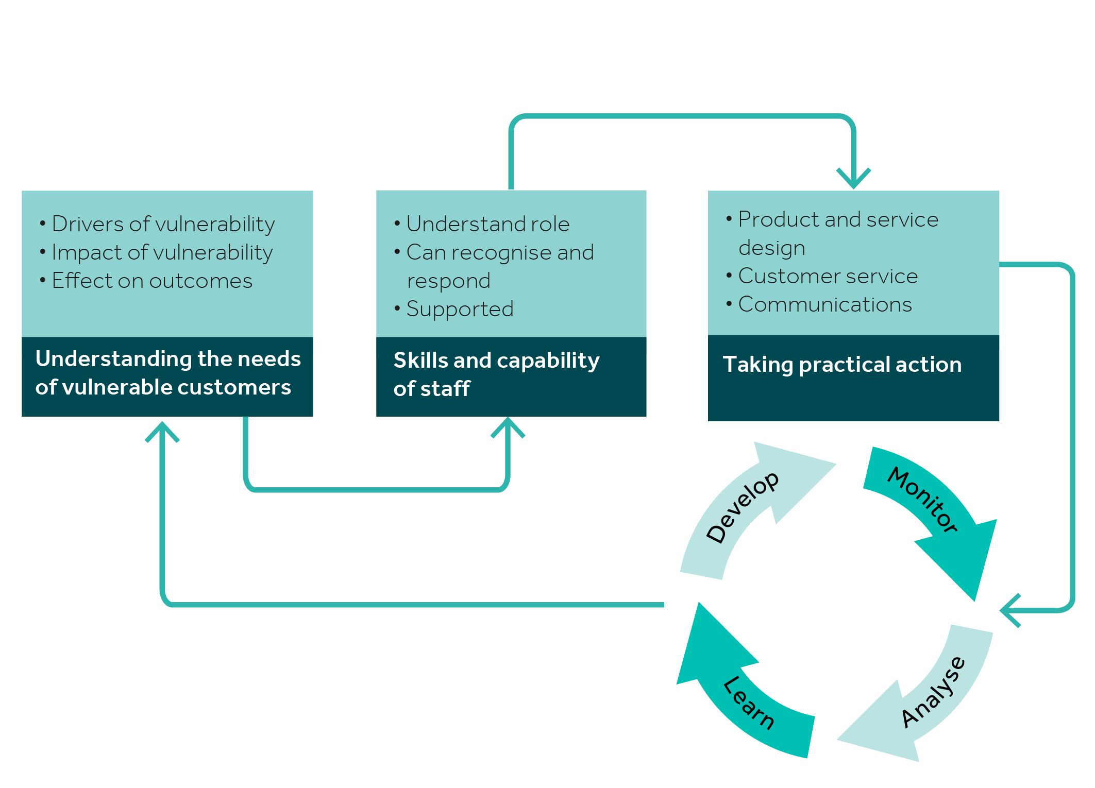
Key areas of focus
Frontline staff.
Product development.
Culture from senior leaders.
Policies and processes must embed the fair treatment of vulnerable customers.
The key is to apply some general principles around communication and ensure these are being utilised (and evidenced) but also ensure there is flexible service provision and communications (e.g. channels).

Slide 62
Critical areas for training/review
Communication channels.
Questioning skills to identify vulnerability.
Listening skills and creating safety.
The voice of possibility.
Talking.
Plain language.
Paraphrasing.
Concept checking.

Slide 63
Why these skills are important
The Guidance states that the term “vulnerable” should not be used in communications with customers.
The Guidance states that staff should be able to recognise indicators of vulnerability. It starts with questioning (in my view).
The requirement is to pro-actively recognise and encourage disclosure but staff are not expected to go further.
Staff should pro-actively ask in a sensitive way if the customer´s needs may be affected or offer a service that is available.
Referral is then made to a specialist team.
Notes must be made to avoid future harm.

Slide 64
Communication channels
We must respect the customer´s preferred communication channel.
Regularly check with them and keep a note.
Do they need access to a specialist team?
Just over 30% of customers say that their insurer or financial services provider regularly respects their preferred communication channel.

Slide 65
Questioning skills
Good questioning skills can be used to identify vulnerability.
Use open questions: “tell me about …”.
Use probing questions: “I want to understand a bit more, can you give me some examples …”
Avoid leading questions: “presumably …”
The Guidance states that if the customer doesn´t want to disclose information it may not be reasonable to continue asking questions.

Slide 66
Listening skills and creating safety
The customer is not always right but must always be listened to.
Discriminative listening: listen for emotion as well as the words.
Creating a mutual purpose and empathy. Never say “but/however…”
Control and labelling are typical examples of when safety is at risk:
“insurers are all the same, the service is awful, they write policies in gobbledygook to take money and never pay out.”
Clearly safety is at risk but it is also a sign they lack facts so they resort to stereotyping. Try to get some examples. “Help me to understand why you think that way.”
You may not be able to resolve the issue there and then but you should aim to progress the conversation. Always try to focus on the solution and not the problem.

Slide 67
Always use the voice of possibility
What else is possible? The obstacle becomes the way.
Never use:
the voice of power (that is how it is)
the voice of reason (I am only an employee)
the voice of avoidance (let´s not discuss that now)
The voice of possibility must always speak the loudest.
If you really can´t help, then signpost. Progress the discussion.
Why Are We Yelling? by Buster Benson.

Slide 68
Talking
What should be one of the most basic of all skills is the one that is so often neglected.
You cannot assess the customer´s true state through email and it is information impoverished.
Use the phone or video conferencing or meet face-to-face as much as possible to ensure you can understand the customer´s situation and use discriminative listening skills.
Paragraph 4.72 references firms needing to ensure that frontline staff have sufficient time to talk with vulnerable customers.

Slide 69
Plain language
The FCA made clear in the guidance that product design and asymmetry of information are critical factors.
Is gobbledygook “intentional” or “unintentional harm”?
The Guidance says that firms must take steps to reduce complexity of products.
We have already looked at this in the previous section and the importance of concept checking.

Slide 70
The due observance and fulfilment of the terms so far as they relate to anything to be done or complied with by the Insured and the truth of the statements and answers in the Proposal shall be conditions precedent to any liability of the Company to make any payment under this policy.
Taken from ‘Language on Trial’ by the Plain English Campaign

Slide 71
We will only pay under this Policy if:
you have kept to the terms of the Policy; and
the statements and answers in your Proposal are true.
Taken from ‘Language on Trial’ by the Plain English Campaign

Slide 72
Summary
Communication channels.
Questioning skills to identify vulnerability.
Listening skills and creating safety.
The voice of possibility.
Talking.
Plain language.
Paraphrasing.
Concept checking.

Slide 74
Recognising and handling behavioural biases throughout the customer journey.

Slide 75
The link to the Consumer Duty
Biases can result in customer harm if exploited and can result in the customer not getting the best outcomes if not recognised and handled properly.
A lot of this aspect will come down to product design and testing (better with consumer groups in controlled experiments).
This section will highlight some key issues you need to be aware of when communicating with and supporting customers.

Slide 76
The link to the Consumer Duty
Paragraph 5.5:
“Firms should proactively consider how consumers’ behavioural biases … might lead their products or services to cause foreseeable harm.”
Paragraph 8.10:
“Firms should act in good faith and avoid designing or delivering communications in a way that exploits consumers’ information asymmetries and behavioural biases.”

Slide 77
Bias in automated decision-making
Paragraph 5.12 deals with examples that would constitute not acting in good faith:
“Using algorithms, including machine learning or artificial intelligence, within products or services in ways that could lead to consumer harm. This might apply where algorithms embed or amplify bias and lead to outcomes that are systematically worse for some groups of customers, unless differences in outcome can be justified objectively.”

Slide 78
What is behavioural economics?
It is the study of how our decisions are affected by social and psychological influences.
Traditional economic theories assume that human-beings are rational and are able to calculate a benefits/costs analysis in an objective manner.
In essence, behavioural economics focuses on limits to rational decision-making and how these can be overcome.
In turn, we can learn how to “nudge” our clients towards better decisions. But “nudging” must be done in the right way.

Slide 79
We also need to understand expectations
Explicit expectations: What are they looking for? What are they “hiring” your product or service to do?
Implicit expectations: what they expect from previous experience.
Interpersonal expectations: customer service.
Digital expectations: self-service.
Dynamic performance expectations: how products and services develop and adapt to market conditions.

Slide 80
Nudging
When we recognise that people have cognitive biases and we recognise their expectations, we can begin to think about how we “nudge” them.
A nudge is a subtle way of addressing a person´s underlying cognitive processes and so they make decisions that are in their interests on an objectively informed basis.
It is not about manipulating! It is about making it easier for a person to decide and act!

Slide 81
The “job to be done” theory in insurance
Investment: those who focus more on claims and see the payment of a premium as a worthwhile expenditure.
Satisfying requirements: the insurance is a sub-goal of satisfying the main goal of home ownership/car ownership etc.
Emotional goals: reduction of anxiety and avoidance of anticipated regret with a focus on outcome rather than probability.
Satisfying social norms / cognitive norms: even though the risk hasn´t changed, people will follow the herd or be subject to availability heuristics .
Source: Insurance & Behavioural Economics by H. Kunreuther et al

Slide 82
Some key issues to be aware of
Confirmation bias: customers will typically look for evidence to support their own beliefs. Particularly prominent with views on risk.
Sunken costs fallacy: once time or money has been invested, even if a product is not performing, they may be tempted to invest more!
Friction avoidance and reducing cognitive load: customers may decide to do nothing (such as switch) if they don´t have to think about it.
Urgency: customers make the wrong decisions when they feel urgency or scarcity.

Slide 83
The affection effect
Research from University of Chicago & Wharton Business School, University of Pennsylvania.
Traditional economic theory would assume rational people carry out a cost/benefit analysis. Do you think that is the reality?

Slide 84
This research showed that price sensitivity decreases the more affection someone has towards the object to be insured, even though a higher price brings no more benefits.
The research concluded that when making buying decisions, people are anticipating their future feelings as well as their current feelings towards a particular object.
Be careful around emotive language.

Slide 85
The less you know, the more you are afraid (the familiarity effect)
Research into risk perception of investment products.
People are affected by current emotions.
It is all about how people “feel”.
Familiarity: it explains why many investors forego diversification in portfolios when probability on return may be greater. How does this translate to insurance?
Self-perceived knowledge is the indicator to look out for. Build familiarity over time. The knowledge gap needs to be filled. Explore where they are getting their “information from”.

Slide 86
Recency & herd effect
Recency of high profile events or experience from others results in people buying products even though their potential exposure has not altered. Be aware of referencing recent examples if it is not likely to alter their specific exposure.
Herd effect / conformity: people follow a group´s judgement. This is particularly linked to the ambiguity effect. When people are uncertain, they follow the herd! Be careful of phrases you use.

Slide 87
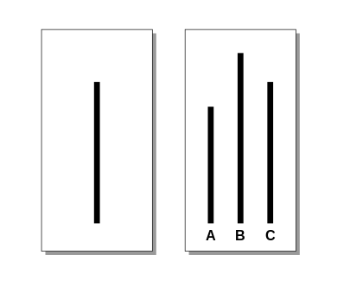
The Asch experiment

Slide 88
Testimonials or stats v stories
Move away from focusing purely on features and benefits. Reduce the cognitive overload.
Our products and services are so much more than information.
People don´t buy the product or service, they buy what it is going to do for them.

Slide 89
Focus on the job, not the product or service.
Normal …… revelation …… new normal.
Focus on characters and not the product. Include character traits.
How was the course of life changed? What was the moment this happened? Think about the audience.

Slide 91
Restatement of learning objectives
During this session, we have:
identified the key requirements relating to consumer understanding and consumer support under the Consumer Duty.
understood the key elements of outcomes-based regulation and skills necessary to evidence outcomes.
learnt how to implement a strategy to utilise the skills taught to remain on the right side of the new Consumer Duty

