Slide 1




Hard Talk:
how to communicate with customers about price rises and other impacts of a hard market
by
Jeff Heasman MABP, PGCert CELTA, LL.B (Hons), LL.M
Certified Practitioner Member of the Academy of Modern Applied Psychology
Member of the Association for Business Psychology
linkedin.com/in/jeffheasman

Slide 2


Learning objectives
By the end of the webinar, participants will be able to:
identify key communication skills for messages about price and cover in a hard market.
understand how and why customers react to certain messages they hear.
implement a strategy to communicate in a way that reassures clients and keeps them onboard.

Slide 3
Be proactive and neutral
You need to build in extra time. This enables you to implement the suggested strategy in this session and avoids last minute surprises.
Be cautious as to the extent you blame external factors on potential price rises, cover restraints or inability to source cover.
Many factors have combined to create this situation and they are emotive subjects.
Have data before you go to the client: do you have an idea of cost and cover?
Be careful of criticising insurers: customers don´t distinguish between various actors in the customer journey.

Slide 4
The accusation list
Are there common themes that your client is likely to raise?
Raise them first.
Be confident they are issues they are likely to raise, you don´t want to raise issues that are not there.

Slide 5
Don´t hide behind email and letter
If you are delivering bad or unexpected news, speak to the customer first. Create a touch point. Build in as many touch points in advance as is possible. Work on retaining customers.
Stereotypes are reinforced in email.
People fill in the blanks because emails are generally information impoverished and we overestimate our ability to communicate effectively.
It is very difficult to change the way the message has been processed by the customer, once it has been read.
Humanise the communication.

Slide 6
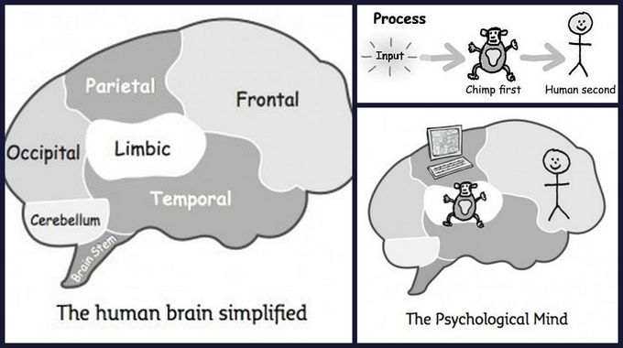
How clients receive and process bad or unexpected news
The Chimp Paradox by Professor Steve Peters.
Is the client focusing on the problem or the solution?

Slide 7
Always use the voice of possibility
What else is possible? The obstacle becomes the way.
Never use:
  the voice of power (that is how it is)
  the voice of reason (it is how it is because of the insurer or because of inflation)
  the voice of avoidance (let´s not discuss that now)
The voice of possibility must always speak the loudest.
If you really can´t help, then signpost.
Why Are We Yelling? by Buster Benson.

Slide 8
Create safety
This is created through mutual understanding and a mutual purpose.
Use inclusive language and the language of reassurance.
If prices are rising and cover is constricting, what can we create as a mutual purpose to reduce costs and gain better terms from the insurer?
Investment in pro-active risk management (see later about expanding the pie!). Use with the insurer. Reduces risk of loss anyway.

Slide 9
Know the client´s priorities
Confirmation bias: client´s are only concerned about price.
Like a negotiation, you have to think what the client´s BATNA could be.
Reservation price: at what point does the client feel indifferent about sourcing options elsewhere.
What do they value the most? What is valuable to them and “cheap to me”? Also known as integrative interests.
On which issues are they least flexible? Identify the differences rather than agreements.
Delay the win-lose and get the win-win in first.

Slide 10
Expand the pie & provide options
Ecosystems are the future. Can you create your own mini-ecosystem?
Equivalent simultaneous offers. Provides control to them and allows you to see what their true values and priorities are:
  preferences
  interests
  needs
  constraints
Don´t just say you understand. Take it further: help me to understand …

Slide 11
Prepare!
Questions to determine interests and priorities.
Language and delivery so as not to isolate.
Strategy.
Challenge 1 | Mitigation strategy | Challenge 2 | Mitigation strategy

Slide 12
MESOs
Multiple Equivalent Simultaneous Offers.
The power of 3 (assuming there are three credible options).
The client will feel empowered, though you retain control.
The IKEA effect.

Slide 13
Walking away
ALWAYS, walk away using the voice of possibility.
When you are going to walk away:
  acknowledge the positives/progress that was made in the negotiation.
  acknowledge that you are sure all parties would have liked an agreement.
  emphasise that you have already conceded all that you could in search for a deal.
  emphasise that you will remain in touch and that the information shared and the relationship built during the process will serve as a solid foundation for the next renewal.

Slide 14
Doing the deal
You almost follow the same principles as when walking away in terms of:
  acknowledge the positives/progress that was made in the negotiation and how the relationship was strengthened by the process.
  acknowledge the positives that you and they were looking for a deal and you obtained one.
  emphasise that you are grateful that, like you, they made concessions to see that a deal was reached.
  emphasise how you feel the whole process has been a positive experience.

Slide 15
Summary
Be proactive (create touch points) and be neutral.
The Power of Talk.
Is the client focusing on the problem or the solution?
Use the voice of possibility. Especially if you have to walk away.
Create safety with a mutual purpose.
Know the client´s priorities.
Expand the pie and provide options.
Prepare!

Slide 16
Restatement of learning objectives
During this webinar, we have:
identified key communication skills for messages about price and cover in a hard market.
understood how and why customers react to certain messages they hear.
Learnt how to implement a strategy to communicate in a way that reassures clients and keeps them onboard.

Slide 17


