Slide 1
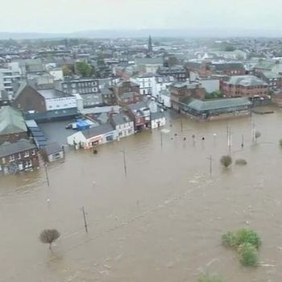
Claims Handling By Alan Chandler Chartered Insurer
Dumfries – this illustrates why insurance is so important.

Slide 2
Alan Chandler, Chartered Insurer e mail alanchandler@uwclub.net
I have trained more than 2,000 individuals to become ACII qualified
I have trained over 50% of the individuals in the last 8 years that have gone onto achieve the highest ACII pass in the whole of the UK.
I train to a pass rate of more than 96% in all CII qualification levels. Certificate , Diploma and Advanced Diploma.
I have delivered the Allianz scholarship and academy programmes in both the UK and Ireland and the Ask Alan facility for Zurich.
I have delivered training throughout Europe for many major brokers and insurers.
I have trained students who have won national prizes in almost all ACII subjects including Insurance Law (MO5), Liability (M96), Commercial Property and BI (M93), Personal Lines Insurance (P86), Business and Finance (M92), Underwriting Practice (M80), Advanced Underwriting (960), Claims Practice (M85), Advanced Claims (820), Marketing (945), Advanced Broking (930) and Advanced Risk Management (992).

Slide 3
Learning Objectives
Delegates will be able to:
Understand how insurance claims operate.
Understand the importance of early claims notification.
Understand when an external outsourcer is usually appointed.
Understand why insurers must not delay settlement because of the Enterprise Act 2016.
Understand the obligations on both the insured and insurer in the event of a claim.

Slide 4
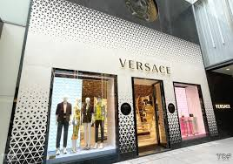
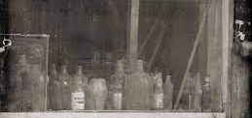
Claims are an insurers shop window – how clean is yours?
Insurance - You don’t need it until you do!
The claim is when we discover how well the insurance has been set up ,and for many they realise you get what you pay for!

Slide 5

Value your claims staff they are your shop front
Historically many insurers (not all) have under staffed, under trained and under invested in their claims staff – WHY?
Claims is the differentiator – do not just say you are good at claims, be good at claims, employing staff that are motivated, qualified and are supported by great IT.
Stop the reoccurring circle of constant crisis! – we cannot train as we have too much work, so claims staff leave because they are not being trained and see no future, replaced by inexperienced people so backlogs occur, so there is no time to train, so guess what the circle continues!
Some insurers do get their claims staffing right I hasten to add – one of the key tests do claims staff get the same Cii exam opportunities as underwriters?

Slide 6
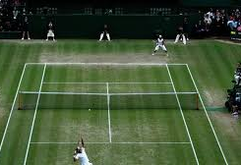
So who has to prove what in a claim fom a legal perspective
Let’s discuss

Slide 7

Claims Notification. Insurers require prompt notification for the following reasons:
To provide opportunity to minimise loss.
So they can be in a position to defend the claim properly.
So they can meet any court or other deadlines.
In order to preserve their subrogation rights.

Slide 8
What happen if there is a delay in claims notification?
Depends on what wording an insurer uses.
On Commercial claims they may not have to show they have been disadvantaged depending upon the wording used – let’s discuss

Slide 9
Enterprise Act 2016
Introduced as an amendment to the Insurance Act 2015
Introduces a late payment clause to ALL policies
Let’s discuss why this is so important in connection with claims.

Slide 10
Claims Handling
Notification
Why is this important - what are the insured’s obligations here?
Assessing Coverage
The claims handler must check various issues:
Does date and time of loss fall within dates of cover?
Has claim been notified as required under the policy?
Does the location of the loss fall within the geographical areas covered?
Is the person making the claim entitled to indemnity under the policy?
Is the peril that caused the loss covered by the policy?
Has the insured complied with all conditions and warranties? (TIA does apply here)
Does anything from the underwriting record conflict with any information on the loss?
Has premium been paid?

Slide 11
Claims Handling
Investigation
Handler needs to decide quickly what further investigation, if any, is required.
May need to use internal or external experts:
Loss Adjusters.
Claims Investigators.
Surveyors.
Medical experts.
Solicitors.
Rehabilitation Specialists
What is their role in each case?

Slide 12
Claims - Investigation
Investigation
For large claims, or for serious or complex losses, the claims handler will normally appoint a Loss Adjuster.
Loss adjusters are paid for by insurers but owe a duty of INDEPENDENCE to BOTH parties
The Adjuster may be asked to:
Investigate the cause of a loss, e.g. was the fire fortuitous or was it started deliberately.
Advise on quantum of the loss - to recommend a reserve.
Liaise with the insured.
Oversee repairs to the property.
Negotiate settlement with the insured.
Or any combination of these.

Slide 13
Instruction of Experts
In all circumstances, effective use of experts is dependent upon a clear understanding of why their assistance is required & provision of clear instructions.
All letters of instruction should contain what?
© .

Slide 14
Supplementary Information:
Other requested information will depend on the class of insurance and type of claim:
Property claims – Google earth for loss locations or online news reports
Fire – Why would a Fire Brigade report be useful?
Theft – Why is a Police report useful?
Storm – weather reports from local meteorological office.
Personal accident claims – Medical reports

Slide 15
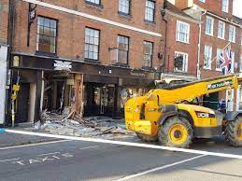
Amount payable of claim (indemnity) may be restricted by:
Sum Insured/Limit of Liability.
Excess
Franchise – so a loss of £100 and a franchise of £100 would mean ? What if the loss was £101?
Other inner limits e.g. target stock
Underinsurance & average = Sum Insured x loss
Correct Value
So Si £100,000 correct value £200,000, a loss of £5,000 would be paid out at ?

Slide 16
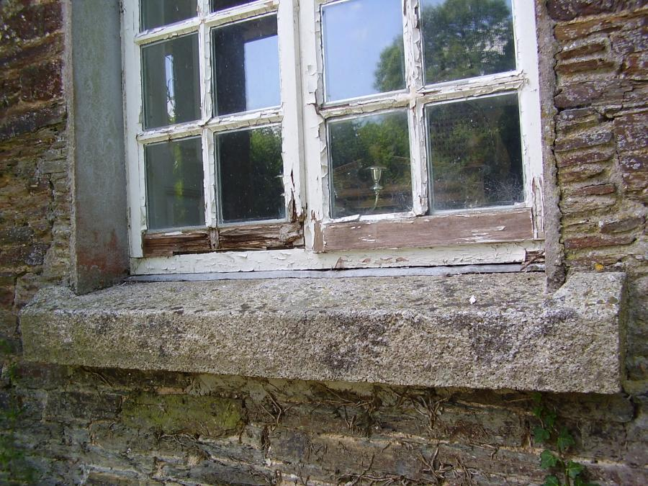
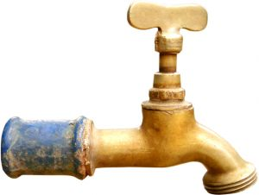
BUILDINGS
Buildings Basis of Settlement – Reinstatement:
Pays for the cost of rebuilding or replacing property at time of rebuilding or replacement – with no deduction for betterment or wear and tear.
Sum Insured must take into account effect of inflation through the period of insurance and through the likely rebuilding period.
Allows insured to receive settlement which is more than a full indemnity.

Slide 17
Indemnity – what happens when the rebuild cost is more than the market value?

Slide 18
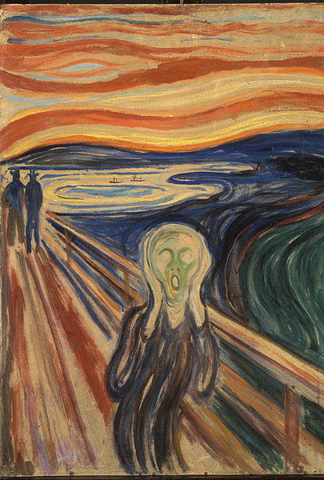
Methods of providing Indemnity
An Insurer can settle a claim by:
Cash
Repair
Replace
Reinstate (as a form of claims settlement)
Does the insured have a legal right to request a cash settlement?
What is an Agreed Value policy – How does settlement work here?

Slide 19
Declinature:
Could arise due to:
Peril not covered by policy.
Failure to comply with a condition or warranty
Evidence of breach of misrepresentation or fraud.
Insurer must reserve rights as soon as possible.
Must abide by FCA rules – claim must be handled promptly and fairly and not rejected unreasonably.

Slide 20
FCA League tables
Want to find out a little more about Personal Lines insurers who pay or don’t! then go onto the FCA league tables.
These exist for Home claims, Personal Accident, Home emergency and Key cover.
They explore by insurer Claims Frequency , Claims acceptance rate and average claim pay out - let’s understand what each means.
Not yet hit Commercial but you can see where the regulator is going here.

Slide 21
Financial Ombudsman Service (FOS)
Provide independent and impartial complaint resolution service.
Those that can refer to the FOS are known as eligible complainants, these are:

Slide 22
FOS remedies
Let’s discuss

Slide 23
Learning Objectives
Delegates will be able to:
Understand how insurance claims operate.
Understand the importance of early claims notification.
Understand when an external outsourcer is usually appointed.
Understand why insurers must not delay settlement because of the Enterprise Act 2016.
Understand the obligations on both the insured and insurer in the event of a claim.

